Slide 1
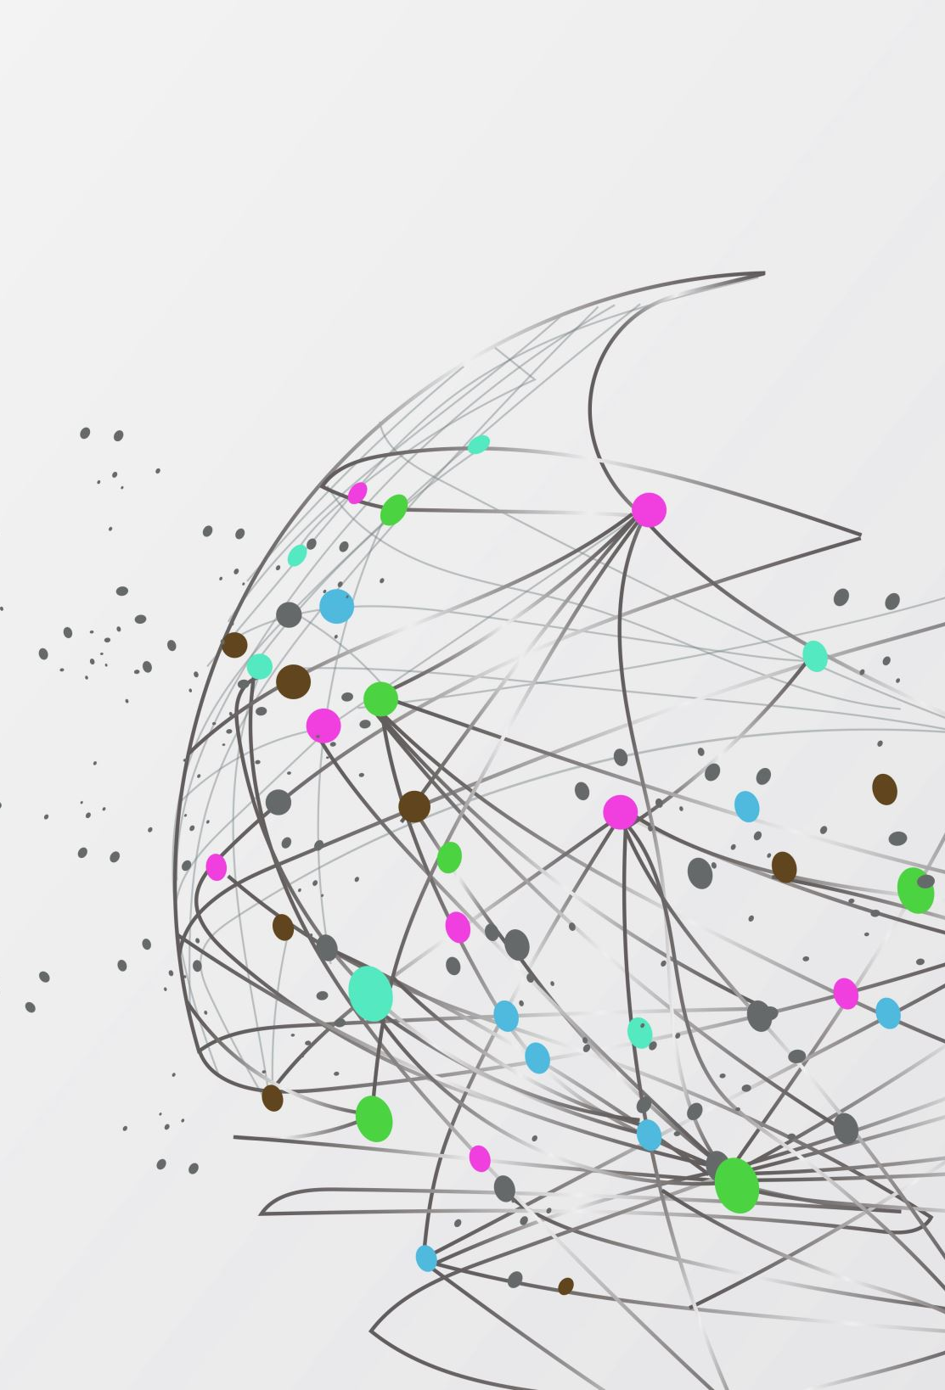
Analyzing COVID-19 Tweets using DistilBERT and Naive Bayes
Members: (Name – SUID )
Sai Karthik Kosuri - 804667002
Rohith Mekala - 957274137
Sai Sreeram Nachireddi - 611833596
Surya Chakra Mani Kuntha Sai Kapisetti - 214073519
Shyam Sudheer Nadella - 3649231521
Murali Venkata Ratna Sai Gunnam - 296770000
Anoushka Mergoju – 328542442

Slide 2
Table of Contents
Introduction
Data source and data cleaning
Analysis
Conclusion
Data Preprocessing and labelling
Model Selection and evaluation
Performance comparison

Slide 3
Introduction
Analyzing COVID-19 Tweets using DistilBERT and Naive Bayes Models is a data mining project aimed at extracting significant information from tweets about the COVID-19 pandemic.
Natural language processing techniques(stop-words, Porter-stemmer) are applied to analyze text data and find patterns, trends, and feelings conveyed in these tweets.
The objective is to reveal hidden patterns and trends that can assist researchers and policymakers better understand the public's perception and response to the pandemic, thereby contributing to the creation of more effective mitigation efforts.
Visualization of the sentiment of the tweets tweeted each day on COVID-19, enabling us to understand how people's opinions and feelings about the pandemic evolve over time.
The initiative intends to use data mining techniques to provide more complete insights into the COVID-19 pandemic.

Slide 4
Data Source and Data Cleaning
Data Source: The information we've gathered comes from Twitter. These are tweets related to covid-19. These tweets are gathered during the pandemic period of corona virus. The factors we evaluated for prediction extraction were the Tweet's Id, Date Posted, Tweet's Text, User Id, and Tweet's Status.
Data cleaning: We cleaned the data by removing duplicates, locating null values in each variable, and using a utility function to remove URLs from the tweet text. We also check the value counts for every class in the target class to determine whether the training and test datasets are balanced.

Slide 5
Data Preprocessing and labelling
With the support of the function named clean responses, we pre-processed the text by removing punctuation, lowercasing all words, eliminating stop-words, and stemming words (Porter stemmer).
Using LabelEncoder, we preprocess the input data to create sentiment labels for each sentiment.

Slide 6
Analysis
The analysis of the COVID-19 tweets in this project was conducted with a comprehensive approach. Three techniques were employed, including:
1) frequency analysis of the number of tweets per day
2) Word Cloud to visualize the most commonly used terms
3) Sentiment Analysis to determine the emotions and attitudes conveyed in the tweets.
This approach provides a multifaceted view of the data, allowing for a more thorough understanding of the topics and emotions surrounding the pandemic on Twitter.

Slide 7
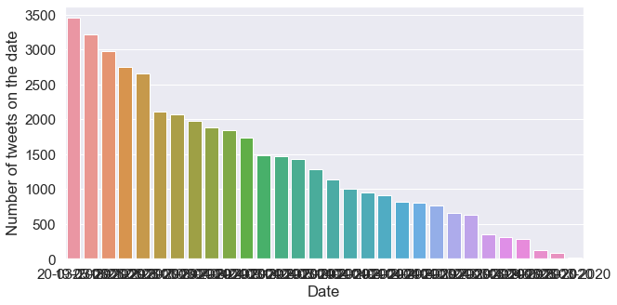
Frequency of tweets collected per day

Slide 8

Word Cloud

Slide 9
Model Selection
Two models were used for sentiment analysis in this project:
1. Naive Bayes and
2.DistilBERT neural network.
The Naive Bayes model is a probabilistic algorithm that uses Bayes' theorem to predict the sentiment of a tweet based on its word features.
The DistilBERT model is a deep learning algorithm that uses a pre-trained transformer-based neural network to generate contextualized word embeddings and make sentiment predictions based on those embeddings.

Slide 10
Sentiment Analysis
Model Evaluation: There are different approaches used for model evaluation. Since our problem falls under classification, we need to identify which class defines a positive result and which one is negative. In our case, we assume that predicting a ‘positive’ class is a positive result. If our model is predicting input text as ‘positive’ and it really has a ‘positive’ label in test data, then it is called True positive. If our model predicted an input text as ‘positive’ though it is ‘negative’ in reality, it is called False Positive. While checking the model performance, we should always consider test data. Using training data will not make much sense as our model will be biased to give the actual prediction.
Confusion Matrix: This matrix helps you to understand the types of errors made by our classifier.
Accuracy: It measures the percentage of correct predictions .i.e the number of correct predictions made by our model divided by the total number of predictions.
Recall: Recall measures the ability of the classifier to find all the positive data points.
Precision: It measures the proportion of correct positive predictions out of all positive predictions made by our model.
F1 score: The F1 Score is the weighted average of Precision and Recall. Therefore, this score takes both false positives and false negatives into account.
We generated an accuracy and confusion matrix to evaluate the model's performance.

Slide 11
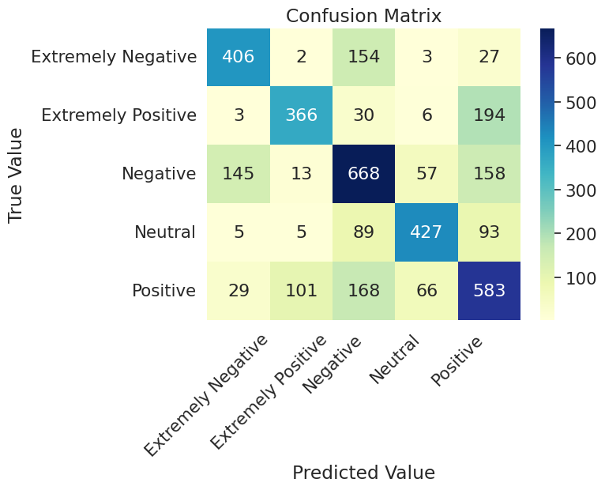
Performance comparison Accuracy and Confusion Matrix values of two models
Naive Bayes: With 5labels
Accuracy: 0.34

Slide 12
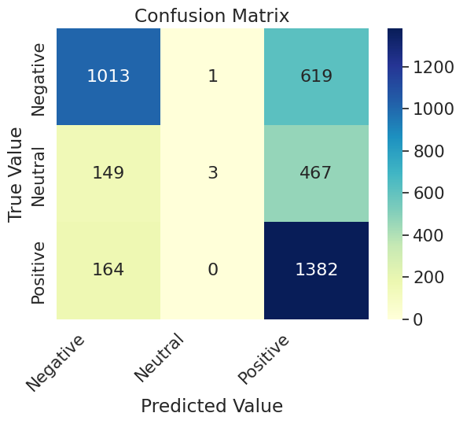
Performance comparison Accuracy and Confusion Matrix values of two models
Naive Bayes:
Accuracy: 0.63

Slide 13
Performance comparison Accuracy and Confusion Matrix values of two models
DistilBert: with 5 labels
Accuracy: 0.64

Slide 14
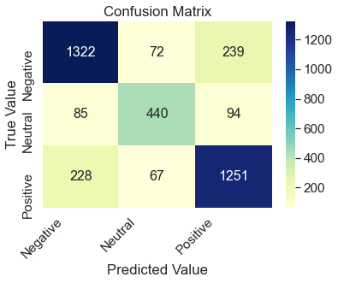
Performance comparison Accuracy and Confusion Matrix values of two models
DistilBert: with 3 labels
Accuracy: 0.79

Slide 15
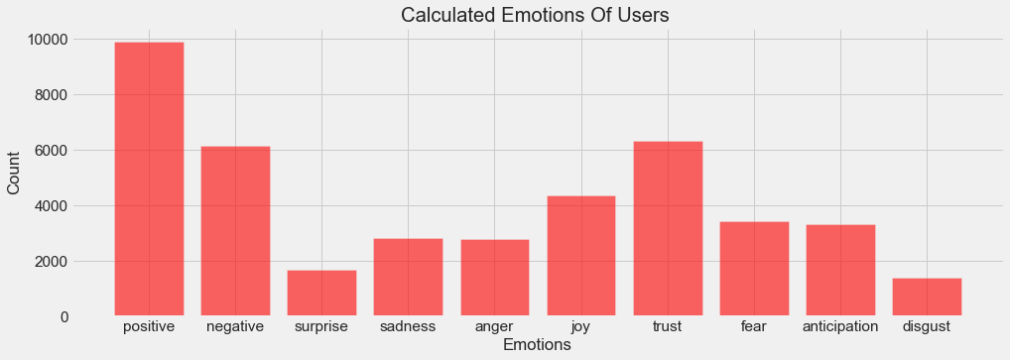
Calculated Emotions of people

Slide 16
Emotion Detection
Created a dataset “nrc emotion lexicon.txt” and retrieved emotions from the dataset.
Performed emotion detection on Covid tweets using RNN.
We used the following emotion labels:- Positive, Negative, Surprise, Sadness, anger, joy, negative, trust, fear, anticipation, disgust.
Used various pre-processing techniques like elimination stop words, removing URL’s, using Porter-stemmer to remove unwanted noise from the data and to improve accuracy.
Created a new column in dataset called labels which contains the dominant emotion label for each tweet.

Slide 17
Model selection for Emotion Detection: RNN
A Recurrent Neural Network (RNN) is a type of neural network that is commonly used for sequence data, such as text. It works by processing the input data one element at a time, while also maintaining a "memory" of the previous elements it has seen. This allows it to make predictions based on the context of the entire sequence, rather than just the current element.
In the context of emotion detection, an RNN can be trained to analyze the emotional content of text data by processing each word in a sentence one at a time and using the context of the previous words to predict the emotion of the current word. By training on a large dataset of labeled text data, an RNN can learn to accurately classify the emotional content of new, unseen text data.

Slide 18
Conclusion
We have done a fair job of improving the accuracy and the confusion matrix results to reduce the false positives and negatives from the models we used in this project.
Starting with the baseline Naive Bayes(NB) model to set the bar for the DistilBERT-based neural network model. We have achieved an accuracy of 63.1% with the NB model to an accuracy of 79.3% with the DistilBERT model.
With the help of callback functions, we improved the training process by stopping it at the 10th epoch(stopping early), retrieving the best model weights, and reducing LR on the plateau (changing the Learning rate when val loss remains the same). Consequently, we enhanced the training procedure.
We performed various comparisons and analysis on the tweets with which we can understand the sentiments of people during covid-19. Out of which, in terms of the model, DistilBert has given a better accuracy and precision for our approach.
Trained emotion detection using RNN model.

Slide 19
Thank You

